Slide 1

Credit Card Fraud Analysis
Using Predictive Modeling
G. Ananth Nath

Slide 2
Contents
Abstract
Predictive Modeling
Existing System
Proposed System
Libraries
Algorithms Used
System Requirements
System Architecture
UML Diagrams
Screenshots
Future Enhancement
Bibilography

Slide 3
Abstract
Financial fraud is a growing problem with far consequences in the financial industry and while many techniques have been discovered. The finance and banking are very important sectors in present day generation, almost everyone has to deal with it either physically or online. Nowadays, most of the transactions are done through online. Billions of dollars of loss are caused every year by credit card transactions. In this, we proposed that fraud detection is a critical problem affecting large financial companies that have increased due to the growth in credit card transactions. This view presents the detection of frauds in credit card transactions, using data mining technique of predictive modeling.
The data set contains credit card transaction of cardholders. Some of the algorithms like Decision
Tree ,Random Forest, SVM and logistic regression are applied on the raw and preprocessed data. Design of this efficient fraud analysis algorithm is key for reducing the losses and more algorithms rely on advanced machine learning techniques to assist investigators.

Slide 4
Predictive Modeling
In this process, we are going to create, test and validate the model. There are different methods in predictive modeling. They are learning, artificial intelligence and statistics.
Once we create a model, we can use many times, to determine probability of outcomes.
So predictive modeling is reusable.
Uses :
Used to analyze the data and predict the outcome.
Used to predict the unknown event which may occur in the future.

Slide 5
Existing System
Network Intrusion Detection System (NIDS):
Network Intrusion Detection system is a mechanism that is used within the network to identify the malicious event.
Host Intrusion Detection System (HIDS):
HIDS also monitors the unauthorized activity. It takes a short review of the existing files in the system.
Disadvantages :
NIDS and HIDS are implemented for identifying existing intrusions based on the id.
If there is any new dynamic intrusion occurs NIDS and HIDS they didn’t detect the intrusions.

Slide 6
Proposed System
The trained data may or may not be dynamic, we can detect the fraud by using the algorithms.
Advantages in Proposed System:
The advantages in the proposed system are as follows:
Logistic Regression is a technique that has been emerged for the analysis of
data for the classification process.
The training data set builds a model and the new unknown data would be
categorized into the proper group.

Slide 7
Libraries
Pandas
Numpy
Matplotlib
Seaborn
Tensorflow
Sklearn

Slide 8
Algorithms Used :
The algorithms which we used to produce the accurate results are as follows:
Logistic Regression
SVM
Local Outlier Factor Detection
K Neighbors Classifier
Decision Tree Classifier

Slide 9
System Requirements
Hardware Requirements :
RAM : 4GB and Higher
Processor : Intel i3 and above
Hard Disk : 500GB minimum
Software Requirements :
OS : Windows 7 and above
Python IDE : Python 2.7x and above
Scripting Language : Python
Technologies : Python and Data Science

Slide 10
System Architecture
Test Set
Unlabeled Features
Fraud Transaction
Feature
Extension
Features and Labels
H
Training Set
Test Training/Building
Test Model Prediction
Historical Data
Non-Fraud
Feature Engineering Process
Testing model Accuracy

Slide 11
UML Diagrams
Use case diagram
Class diagram
Sequence diagram
Collaboration diagram
Component Diagram
State Diagram
Deployment Diagram

Slide 12
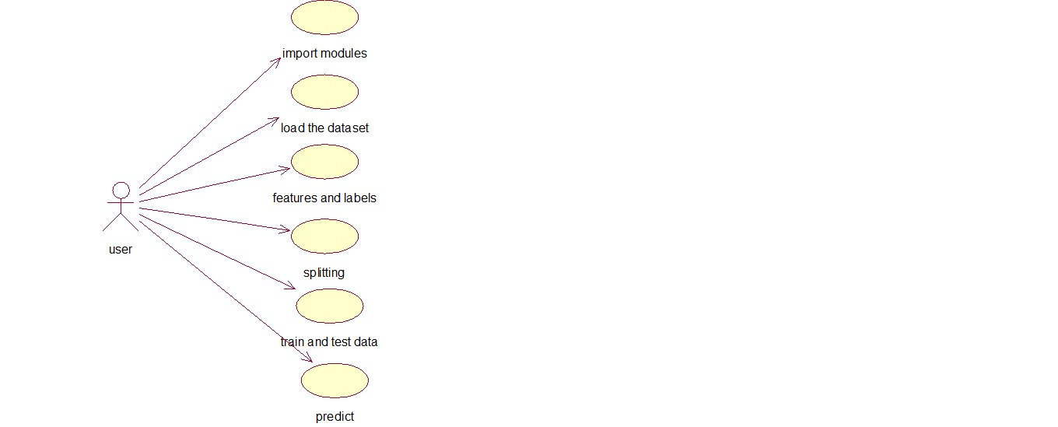
Usecase diagram

Slide 13
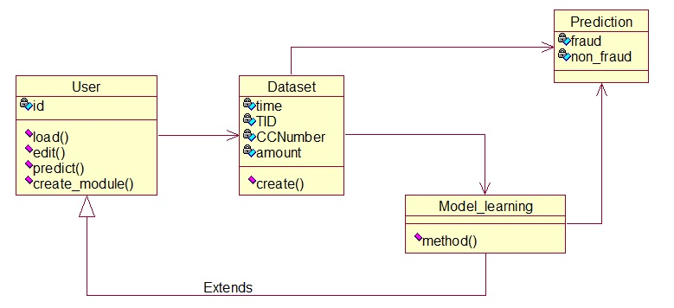
Class diagram

Slide 14
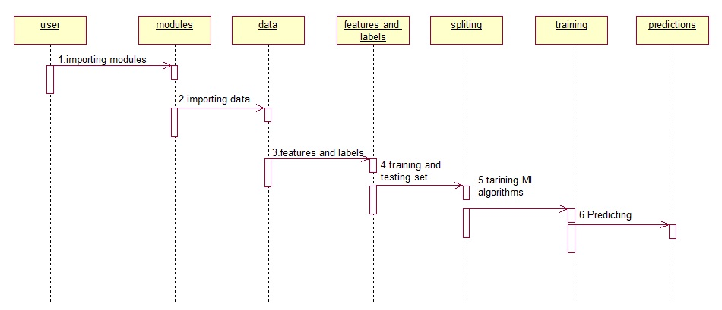
Sequence diagram

Slide 15
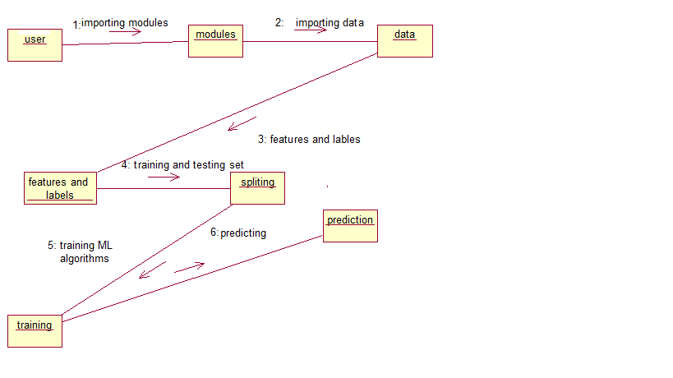
Collaboration diagram

Slide 16
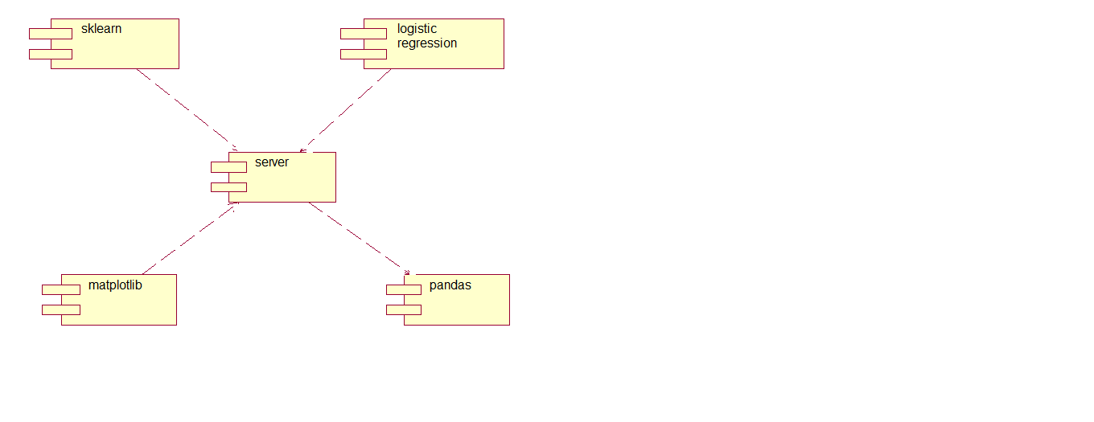
Component diagram

Slide 17
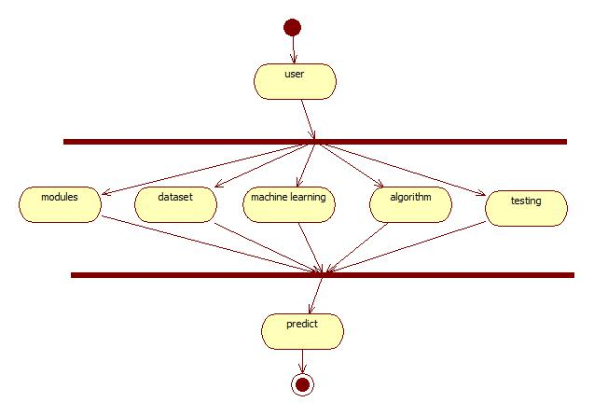
Activity diagram

Slide 18
Deployment diagram

Slide 19
Modules:
The modules required for the project are as follows:
Cleaning the Data
Loading the Data
Analysing the Data
Applying Models

Slide 20
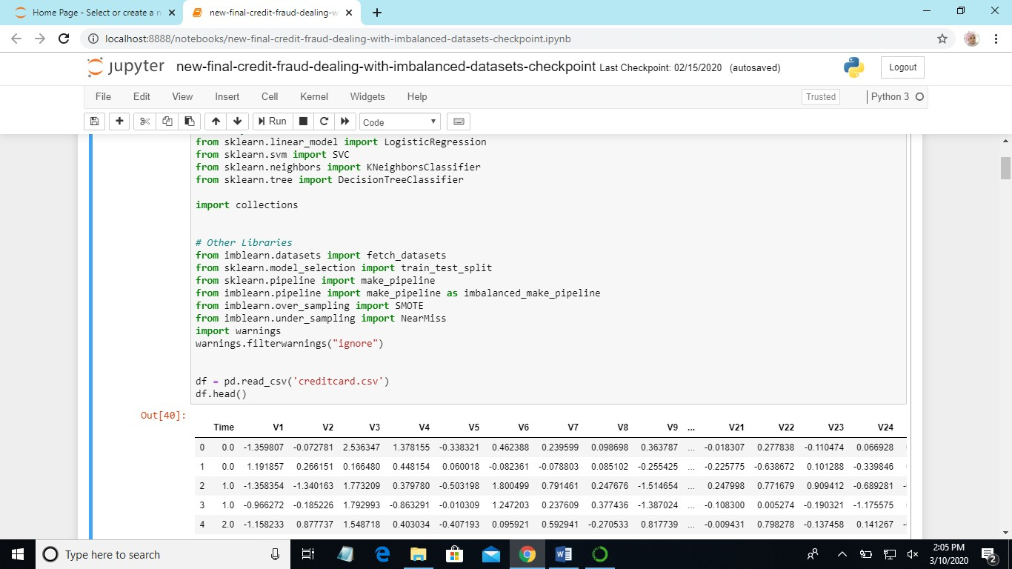
Display dataset:

Slide 21
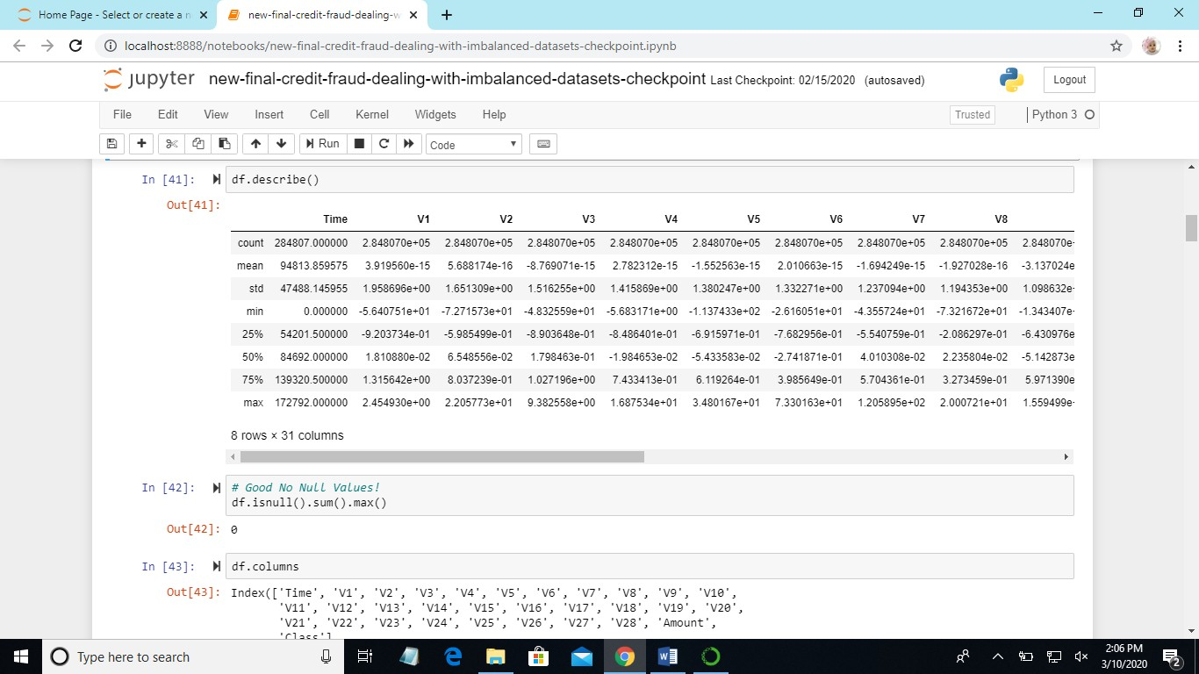
Description of dataset and display columns

Slide 22
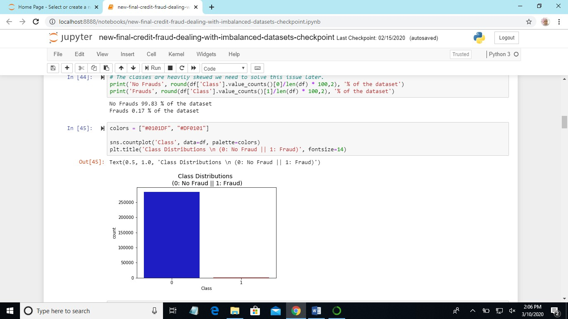
Detection of Fraud and Non-Fraud

Slide 23
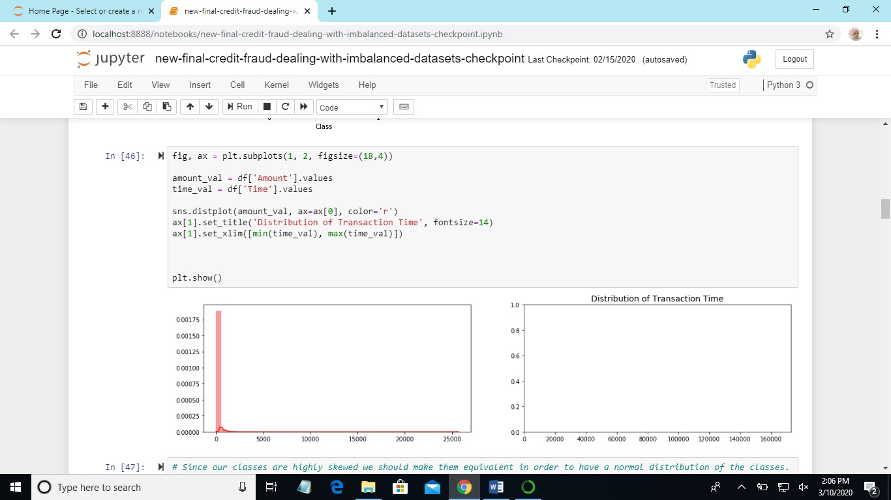
Subplots

Slide 24
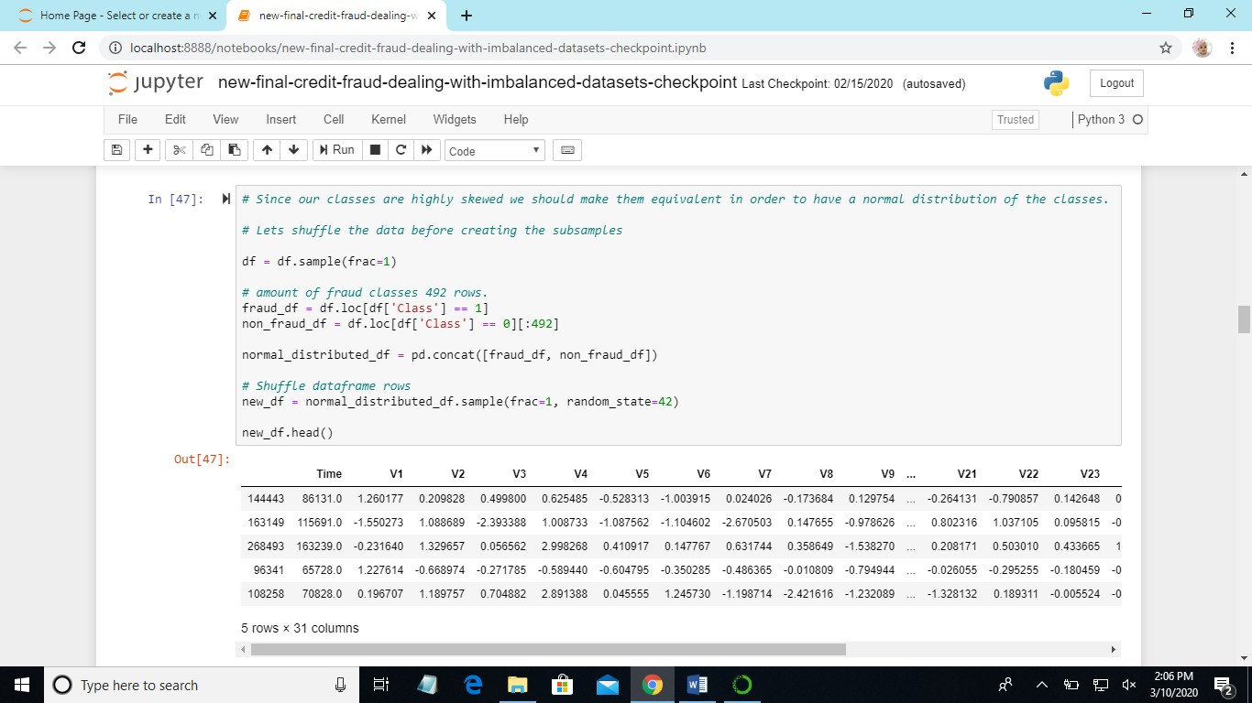
Shuffling of data

Slide 25
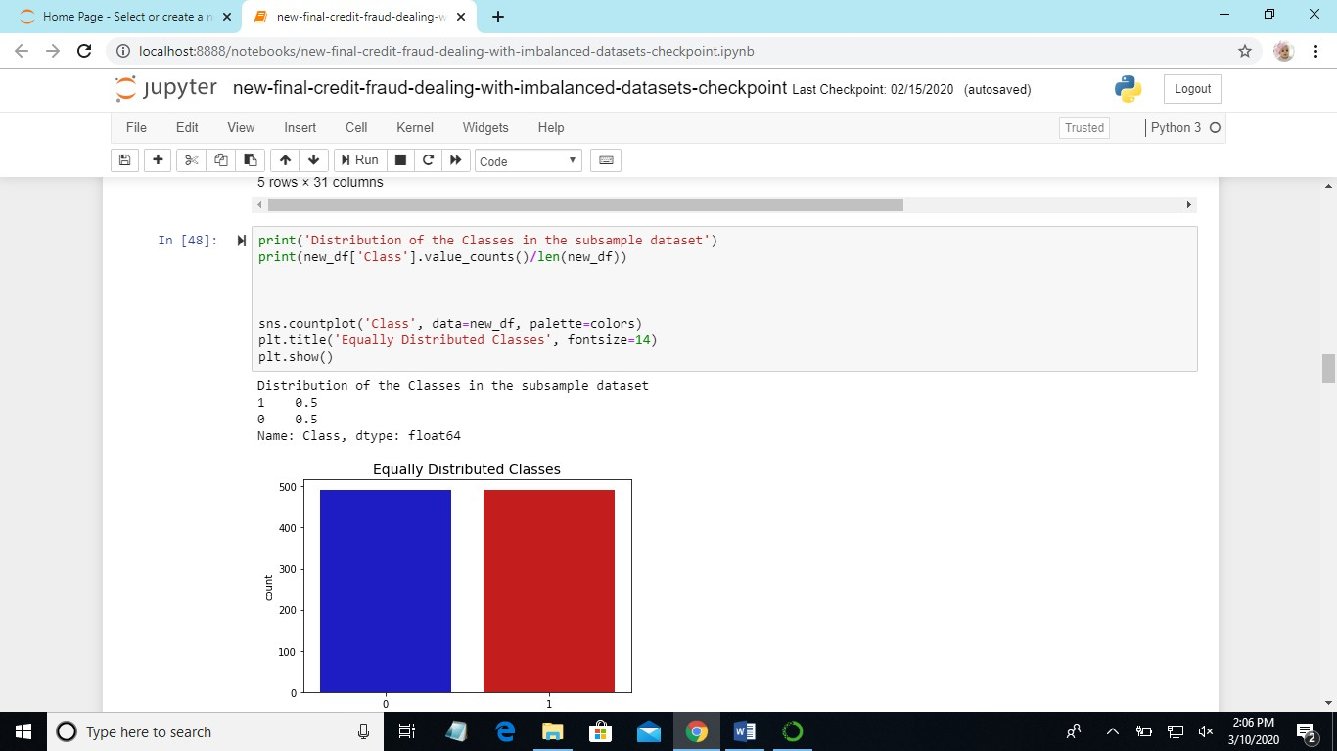
Distribution of classes

Slide 26
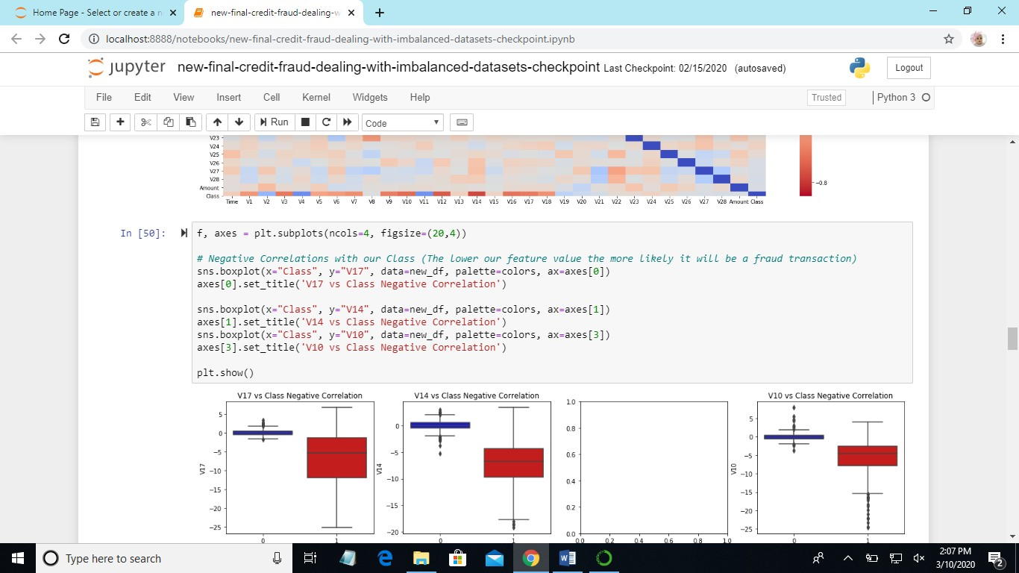
Plotting using different factors

Slide 27
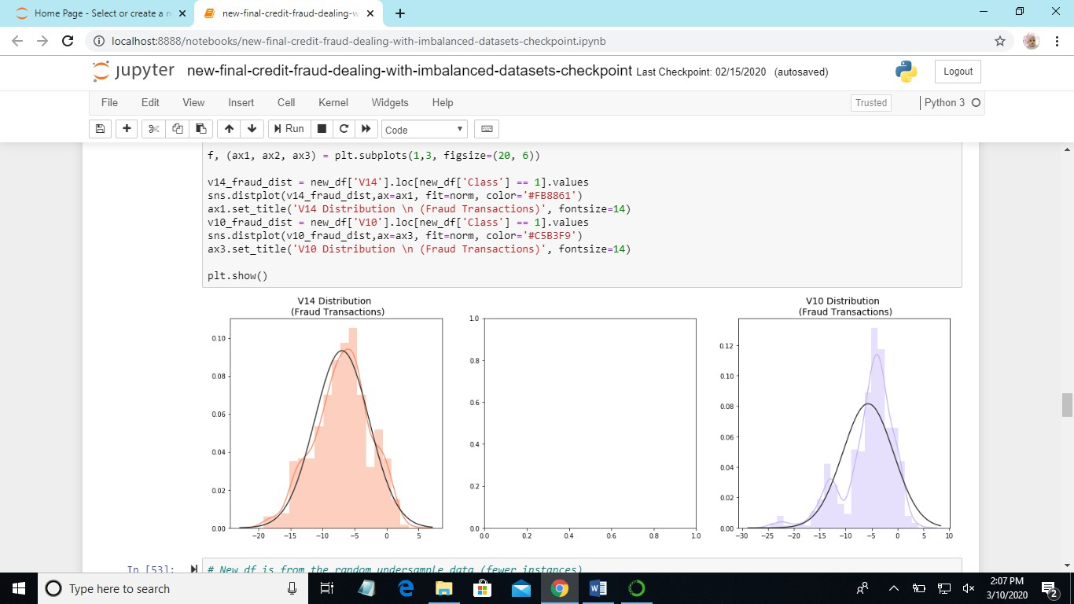
Fraud and Non-Fraud Transactions

Slide 28
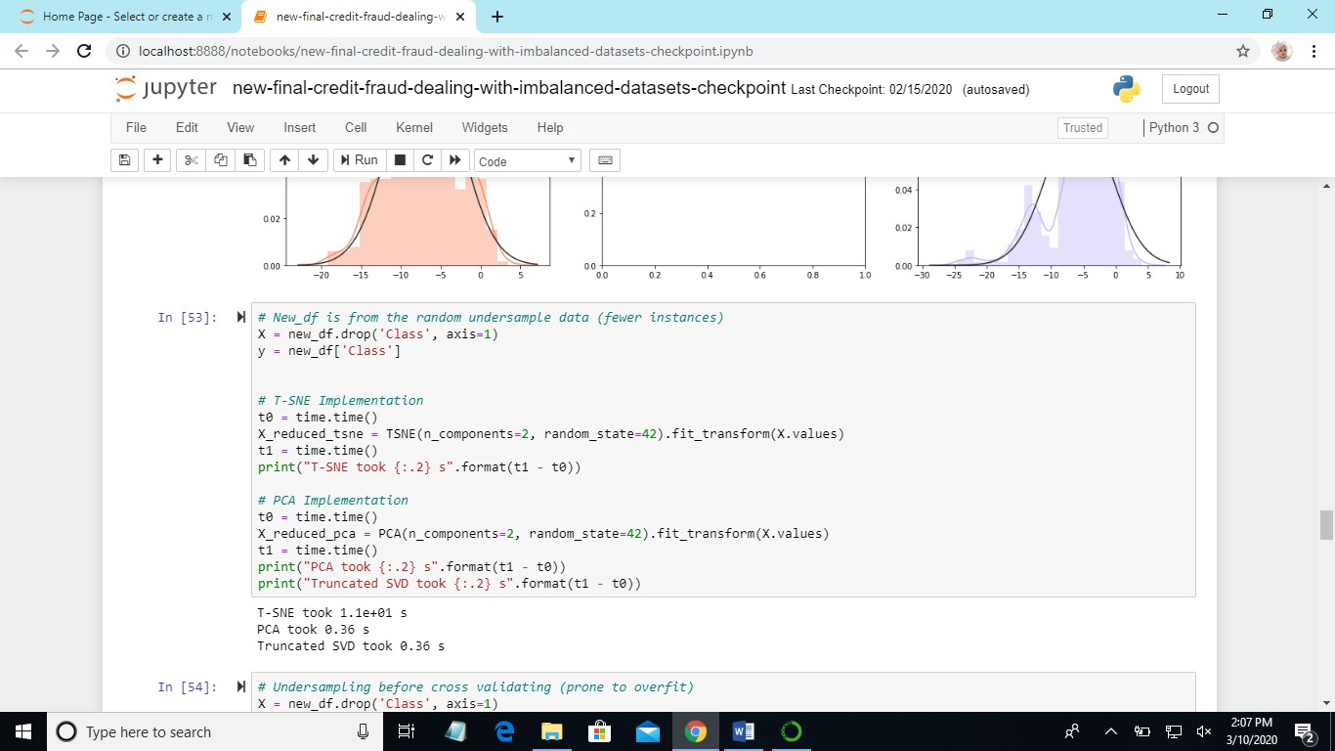
Time Accuracy

Slide 29
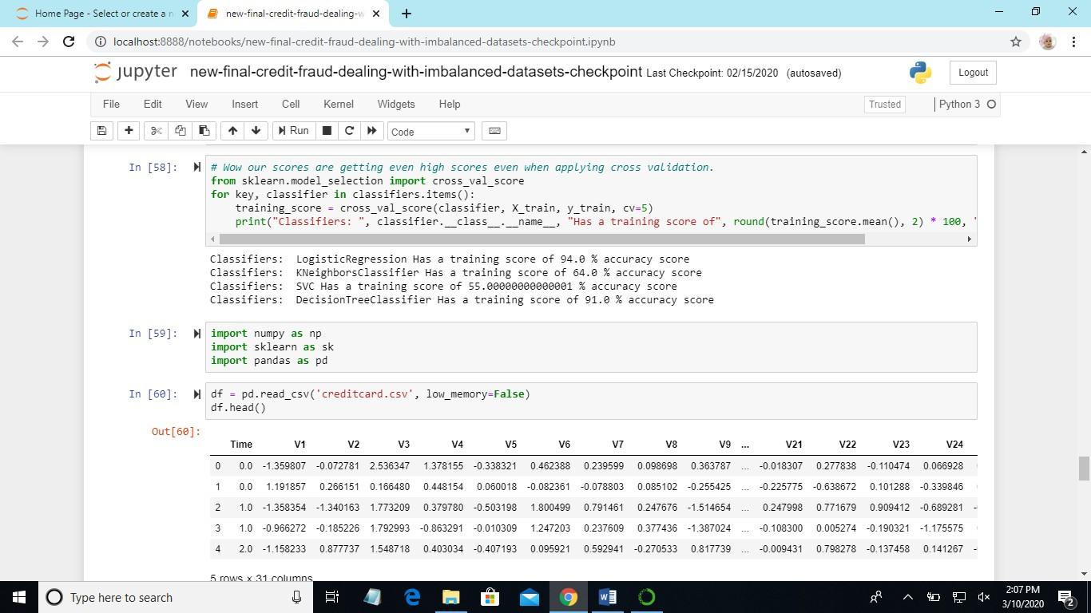
Accuracy score for each classifier

Slide 30
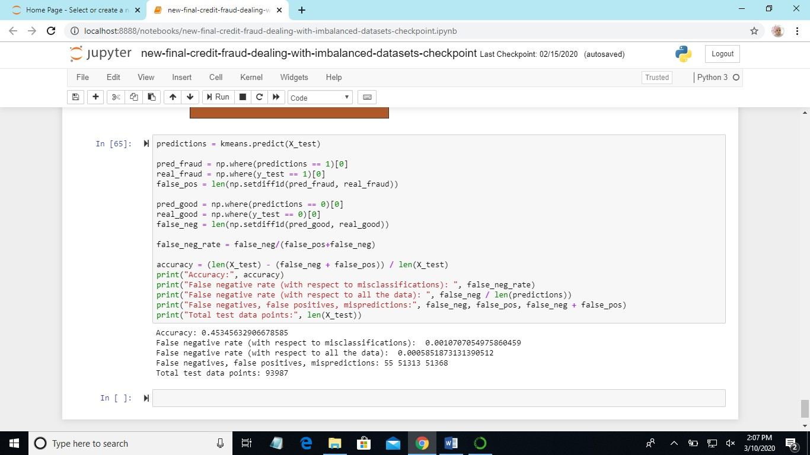
Accuracy Rate Predictions

Slide 31
In this project, IDS based on SVM and random forest along with random projection is implemented. The performance of IDS is evaluated with the help of dataset. The IDS is trained and tested by means of data set. The features along with SVM is 98.5% which is a good detection rate. Finally, we can conclude that SVM is the best classifiers among the other classifiers. As a future work, the proposed IDS can be implemented on network for protecting it from unlawful activity.
CONCLUSION

Slide 32
Previously, in existing system NIDS and HIDS are implemented for identifying existing intrusions based on the id. If there is any new dynamic intrusion occurs NIDS and HIDS they didn’t detect intrusions. So this is major drawback in existing system. Support vector machine is a technique that has been emerged for the analysis data for the classification process. The support vector machine is also known as support vector networks.
Future Enhancement

Slide 33
https://www.anaconda.com/download/ https://www.python.org/downloads/release/python-360/ Modules: Install numpy Install pandas Install matplotlib Install scikit – learn Install seaborn Install Image
BIBILOGRAPHY
S. Bhattacharyya, S. Jha, K. Tharakunnel, and J. C. Westland, “Data mining for credit card fraud: A comparative study,” Decis. Support Syst., vol. 50, no. 3, pp.602–613, 2011.

Slide 34
Thank You….

